Slide 1
Docker / Rkt
Basics
22/01/2020

Slide 2
Some concepts

Slide 3
On this document…
What’s a container?
Containers vs. Virtual Machines
Let’s get started with rkt!
What’s rkt?
Rkt architecture
Some rkt concepts
Running rkt with Vagrant
Rkt Container Networking!
Getting started with Docker
Docker platform
Docker architecture
Docker objects

Slide 4
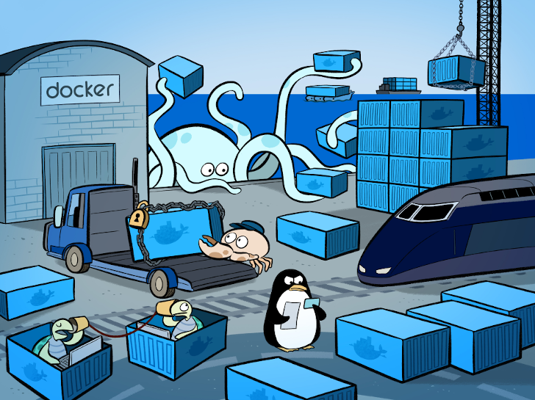
What’s a container?
Fundamentally, a container is nothing but a running process, with some added encapsulation features applied to it in order to keep it isolated from the host and from other containers. One of the most important aspects of container isolation is that each container interacts with its own, private filesystem; this filesystem is provided by a Docker image. An image includes everything needed to run an application -- the code or binary, runtimes, dependencies, and any other filesystem objects required.

Slide 5
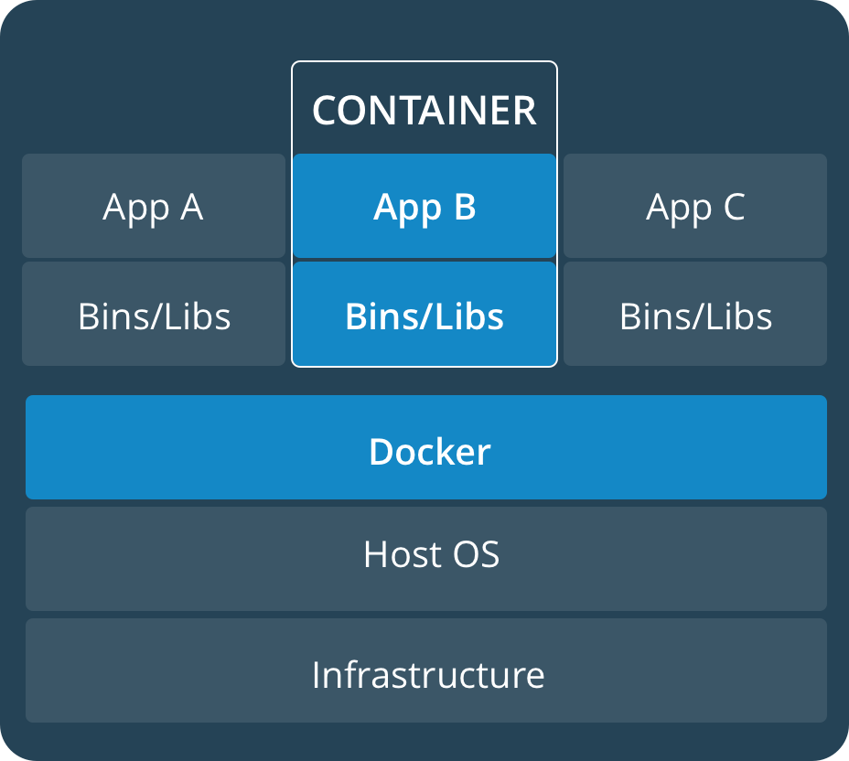
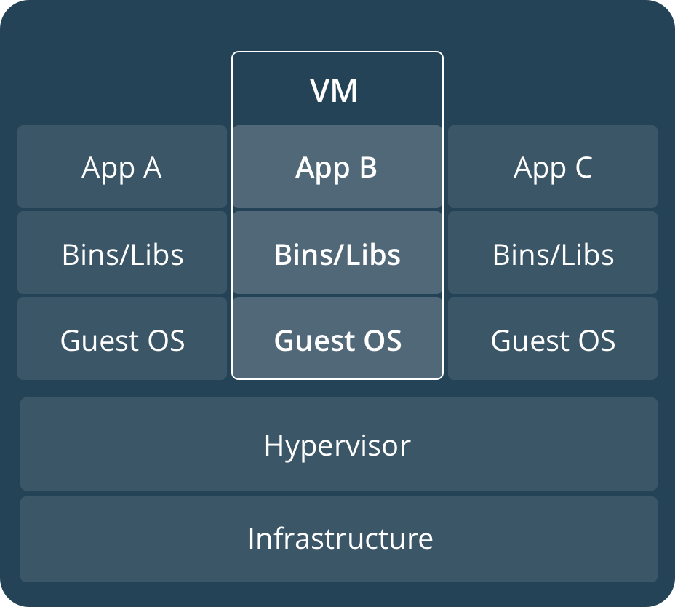
Containers Vs. Virtual Machines
A container runs natively on Linux and shares the kernel of the host machine with other containers. It runs a discrete process, taking no more memory than any other executable, making it lightweight.
By contrast, a virtual machine (VM) runs a full-blown “guest” operating system with virtual access to host resources through a hypervisor. In general, VMs incur a lot of overhead beyond what is being consumed by your application logic.

Slide 6
Let’s get started with rkt!

Slide 7
What is rkt?
rkt is an application container engine developed for modern production cloud-native environments. It features a pod-native approach, a pluggable execution environment, and a well-defined surface area that makes it ideal for integration with other systems.
The core execution unit of rkt is the pod, a collection of one or more applications executing in a shared context
rkt allows users to apply different configurations (like isolation parameters) at both pod-level and at the more granular per-application level. rkt's architecture means that each pod executes directly in the classic Unix process model (i.e. there is no central daemon), in a self-contained, isolated environment. rkt implements a modern, open, standard container format, the App Container (appc) spec, but can also execute other container images, like those created with Docker.

Slide 8
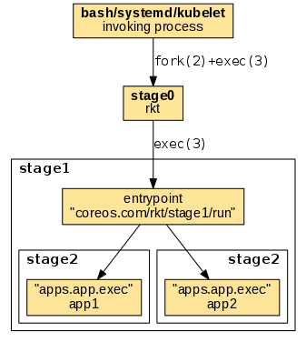
Rkt Architecture
When invoking rkt from shell the stages of execution works as follows:
invoking process -> stage0: The invoking process uses its own mechanism to invoke the rkt binary (stage0). When started via a regular shell or a supervisor, stage0 is usually forked and exec'ed becoming a child process of the invoking shell or supervisor.
stage0 -> stage1: An ordinary exec(3) is being used to replace the stage0 process with the stage1 entrypoint. The entrypoint is referenced by the coreos.com/rkt/stage1/run annotation in the stage1 image manifest.
stage1 -> stage2: The stage1 entrypoint uses its mechanism to invoke the stage2 app executables. The app executables are referenced by the apps.app.exec settings in the stage2 image manifest.

Slide 9
Some rkt concepts
What is an App Container?
App Container (appc) is an open specification that defines several aspects of how to run applications in containers: an image format, runtime environment, and discovery protocol.
What is ACI?
The image format defined by appc and used in rkt is the Application Container Image, or ACI. An ACI is a simple tarball bundle of a rootfs (containing all the files needed to execute an application) and an Image Manifest, which defines things like default execution parameters and default resource constraints. ACIs can be built with tools like acbuild, actool, or goaci. Docker images can be converted to ACI using docker2aci, although rkt will do this automatically.

Slide 10
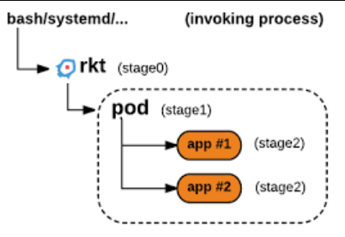
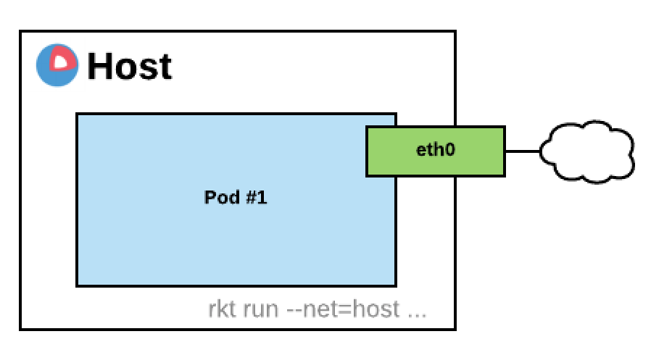
Some rkt concepts
What is a pod?
appc defines the pod as the basic unit of execution. A pod is a grouping of one or more app images (ACIs), with some additional metadata optionally applied to the pod as a whole - for example, a resource constraint can be applied at the pod level and then forms an "outer bound" for all the applications in the pod. The images in a pod execute with a shared context, including networking.

Slide 11
Getting started with rkt

Slide 12
What’s next?
Installing and running over vagrant machine
Reaching pods from outside (container networking)

Slide 13
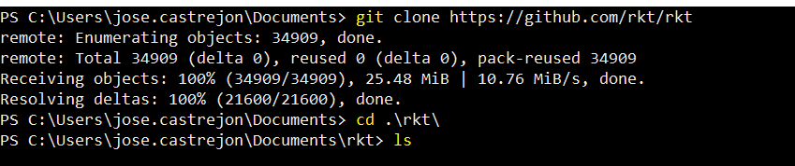
Running rkt with Vagrant
It’s possible to install rkt in all popular (or not) Linux distributions (i.e. Arch, CentOS, Debian, Fedora, openSUSE, Ubuntu, etc.) by using their built-in package manager (like pacman, apt or yum) or by a .deb or rpm package, however we can run over a vagrant machine by following this simple steps:
Make sur you have git installed in you windows host and clone the entire vagrant machine from a Git repo which contains a vagrant image with Ubuntu Xenial. Afterwards perform a cd into the cloned folder on your machine.

Slide 14
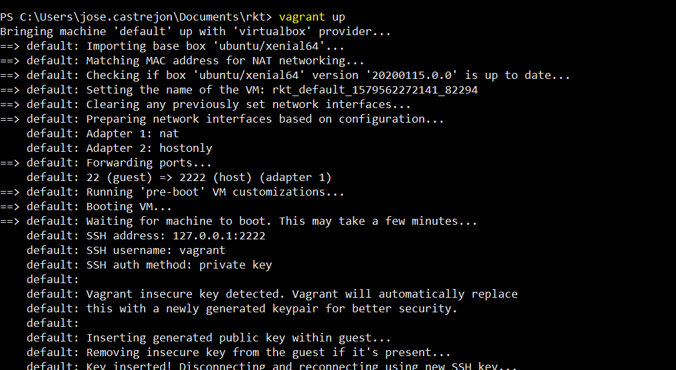
Running rkt with Vagrant
Once you are on the rkt folder, execute vagrant up in order to prepare the vagrant machine environment

Slide 15
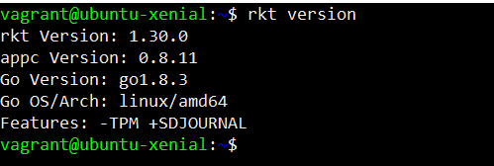
Running rkt with Vagrant
By executing vagrant ssh we are now inside the vagrant machine, so we can check now that rkt is installed by executing rkt version
Now it’s time to run a rkt container with a coreOS image

Slide 16
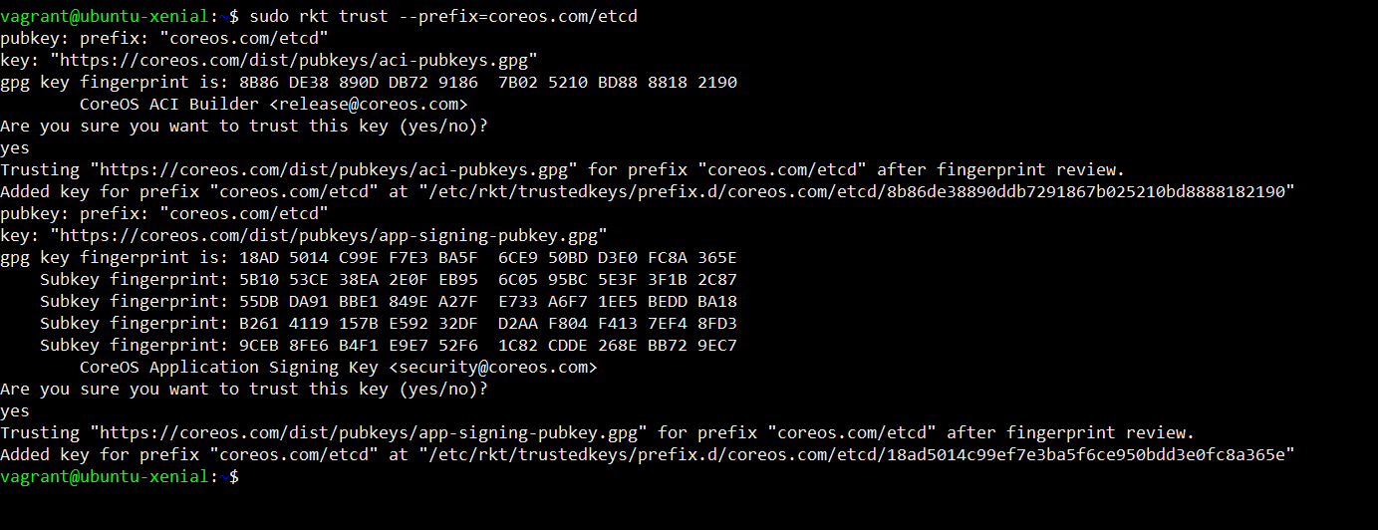
Running rkt with Vagrant
First step is make vagrant machine trust in the authenticity of the rkt image we’re trying to run, so by executing the rkt trust –prefix=coreos.com/etcd we are obtaining the public key and saving it in our vagrant machine as shows bellow:

Slide 17
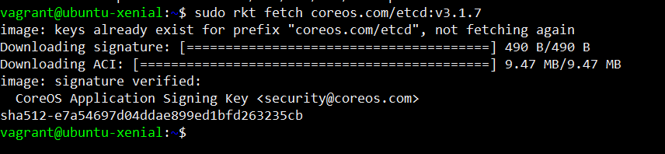
Running rkt with Vagrant
Now, we can fetch the rkt image from a trusted source with rkt fetch plus the name of the image, as you can see this command starts to download the ACI image and their signature, it also generates and show a hash after finish their execution:

Slide 18
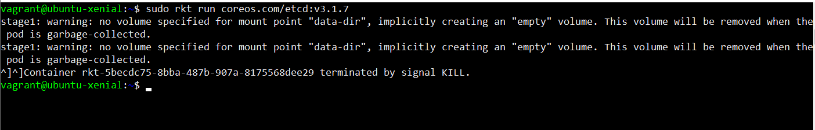
Running rkt with Vagrant
Now, we can fetch the rkt image from a trusted source with rkt fetch plus the name of the image, as you can see this command starts to download the ACI image and their signature, it also generates and show a hash after finish their execution. Afterwards we’re able to run our rkt container by invoking it using the rkt run command and the name of the downloaded image as argument:

Slide 19
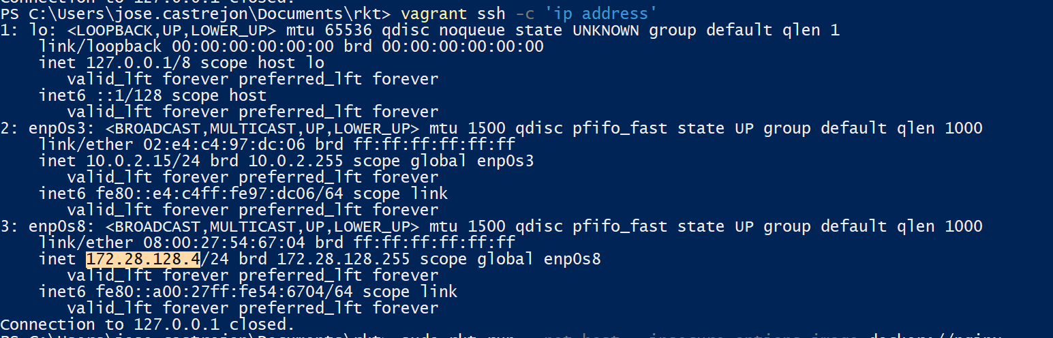
Container networking
By using rkt we are able to reach our pods from outside the host, in this example we are working with a vagrant machine and a rkt image which contains a nginx server. First step is, without start the vagrant machine, run vagrant ssh –c ‘ip address’ from powershell or cmd. It will help us to know what’s the IP address assigned to our vagrant machine.

Slide 20
Container networking
By using rkt we are able to reach our pods from outside the host, in this example we are working with a vagrant machine and a rkt image which contains a nginx server. First step is, without start the vagrant machine, run vagrant ssh –c ‘ip address’ from powershell or cmd. It will help us to know what’s the IP address assigned to our vagrant machine.

Slide 21
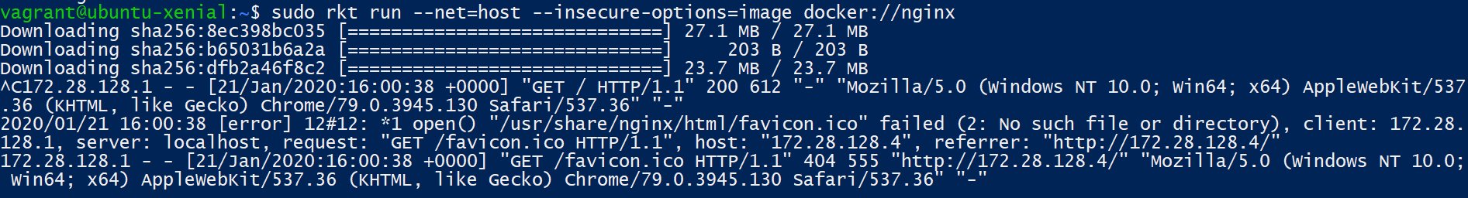
Container networking
Afterwards we have to run an image, in this case we are using a docker image by adding the prefix ‘docker://’ which indicates the source of the desired image (commonly the docker hub). Signature validation it’s not support for Docker images, so we add the –insecure-options as argument. So, once we have the image downloaded it will run and will listen form requests and we now can see that it is accessible from outside

Slide 22
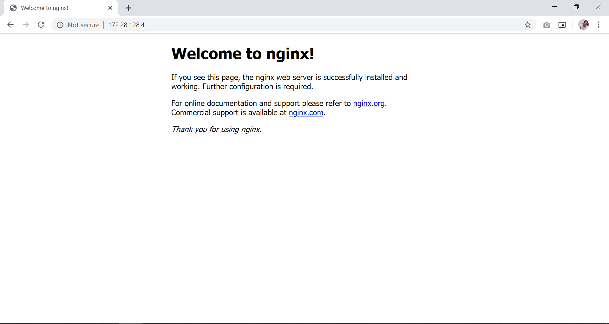

Slide 23
Getting started with Docker

Slide 24
Overview
Docker is an open platform for developing, shipping, and running applications. Docker enables you to separate your applications from your infrastructure so you can deliver software quickly. With Docker, you can manage your infrastructure in the same ways you manage your applications

Slide 25
Docker platform
Docker provides tooling and a platform to manage the lifecycle of your containers:
Develop your application and its supporting components using containers.
The container becomes the unit for distributing and testing your application.
When you’re ready, deploy your application into your production environment, as a container or an orchestrated service. This works the same whether your production environment is a local data center, a cloud provider, or a hybrid of the two.

Slide 26

Docker Engine
Docker Engine is a client-server application with these major components:
A server which is a type of long-running program called a daemon process (the dockerd command).
A REST API which specifies interfaces that programs can use to talk to the daemon and instruct it what to do.
A command line interface (CLI) client (the docker command).
The CLI uses the Docker REST API to control or interact with the Docker daemon through scripting or direct CLI commands. Many other Docker applications use the underlying API and CLI.
The daemon creates and manages Docker objects, such as images, containers, networks, and volumes.

Slide 27
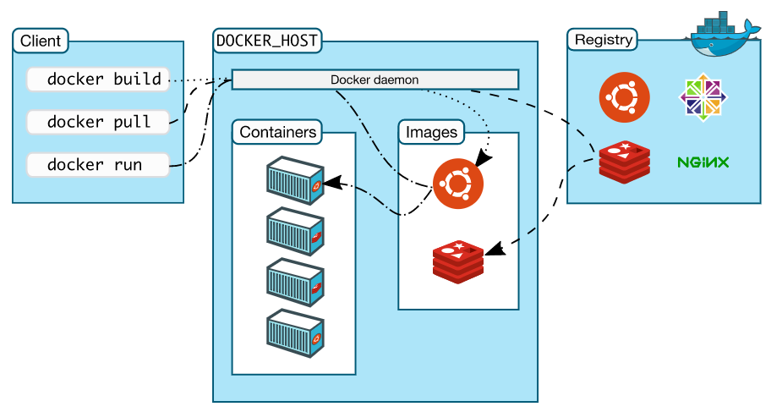
Docker architecture
Docker uses a client-server architecture. The Docker client talks to the Docker daemon, which does the heavy lifting of building, running, and distributing your Docker containers. The Docker client and daemon can run on the same system, or you can connect a Docker client to a remote Docker daemon. The Docker client and daemon communicate using a REST API, over UNIX sockets or a network interface.

Slide 28
Docker objects
IMAGES
An image is a read-only template with instructions for creating a Docker container. Often, an image is based on another image, with some additional customization.
CONTAINERS
A container is a runnable instance of an image. You can create, start, stop, move, or delete a container using the Docker API or CLI. You can connect a container to one or more networks, attach storage to it, or even create a new image based on its current state.
SERVICES
Services allow you to scale containers across multiple Docker daemons, which all work together as a swarm with multiple managers and workers. Each member of a swarm is a Docker daemon, and the daemons all communicate using the Docker API

Slide 29
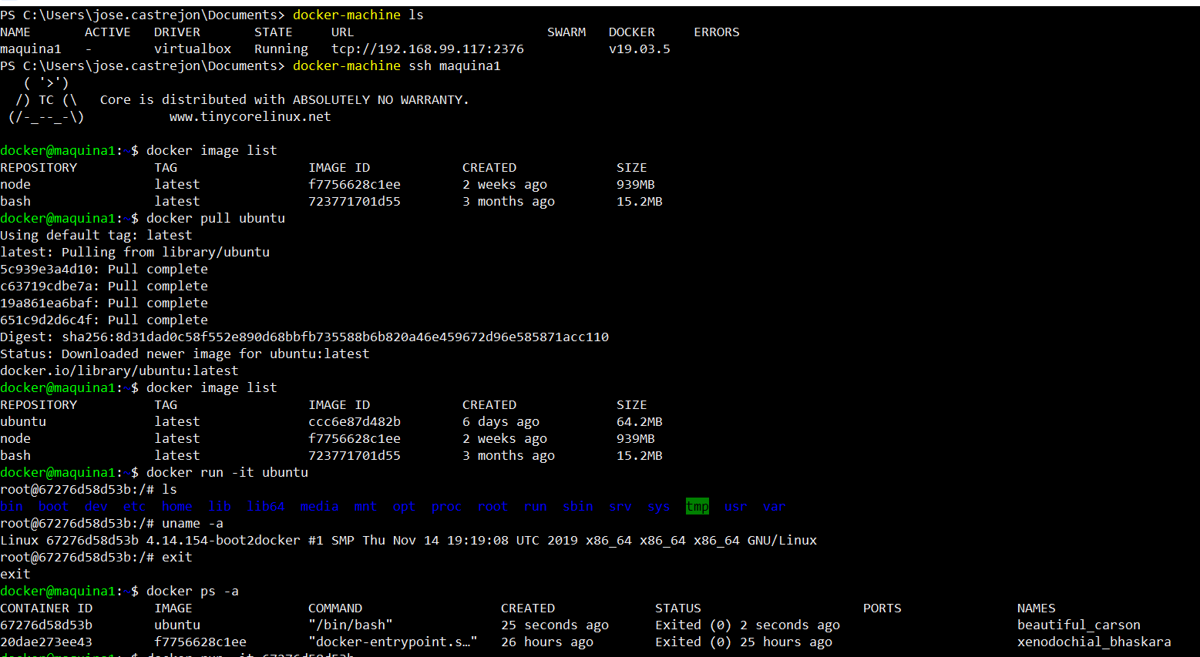

Slide 30
Stay in touch

Slide 31
José Castrejón Aguilar
jose.castrejon@softtek.com

